Slide 1
Kleene’s Theorem
Every Regular Expression can be represented by an FA
We already know that a regular expression has a corresponding FA. However, the difficult part is that a regular expression can be combined with other regular expression through union (sum), concatenation and closure of FA. Thus, we need to devise methods for FA1+FA2, FA1FA2, FA1 Closure.

Slide 2
Kleene Theorem (Union)
If r1+r2 represents a regular expression r3, then FA+FA2 represents an FA3 that correspond to r3.
Start by taking both FA’s initial state and traversing on each input symbol in the respective FA
Since one initial state is allowed in FA, therefore, only one state can be marked as initial state
During the process, any state encountered final, the resultant state will be final. This is due to the fact that multiple final states are allowed in FA.

Slide 3
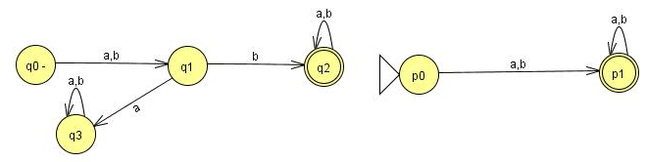
Question
Find FA1 U FA2 for the following:

Slide 4
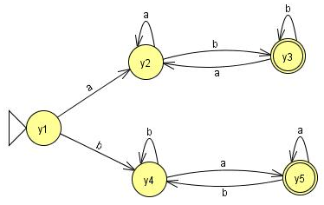
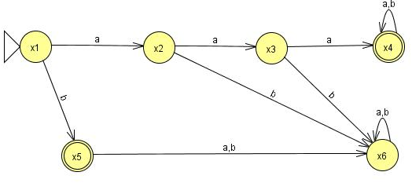
Question
Find FA1 U FA2 for the following:

Slide 5
Old States | Reading at a | Reading at b
z1-≡(x1,y1) | (x2,y2)≡z2 | (x5,y4)≡z3
z2≡(x2,y2) | (x3,y2)≡ z4 | (x6,y3)≡z5
z3+≡(x5,y4) | (x6,y5)≡ z6 | (x6,y4)≡z7
z4≡(x3,y2) | (x4,y2)≡ z8 | (x6,y3)≡z5
z5+≡(x6,y3) | (x6,y2)≡ z9 | (x6,y3)≡z5

Slide 6
Old States | Reading at a | Reading at b
z6+≡(x6,y5) | (x6,y5)≡ z6 | (x6,y4)≡z7
z7≡(x6,y4) | (x6,y5)≡ z6 | (x6,y4)≡z7
z8+≡(x4,y2) | (x4,y2)≡ z8 | (x4,y3)≡z10
z9≡(x6,y2) | (x6,y2)≡ z9 | (x6,y3)≡z5
z10+≡(x4,y3) | (x4,y2)≡ z8 | (x4,y3)≡z10

Slide 7
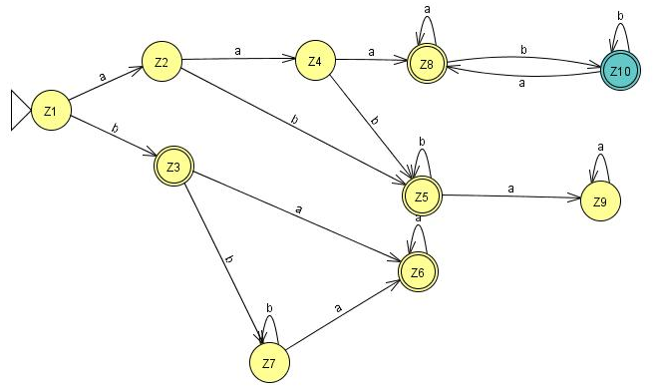

Slide 8
Kleene Theorem (Concatenation)
If r1r2 represents a regular expression r3, then FAFA2 represents an FA3 that should correspond to r3.
Start by taking the first FA’s and traversing on each input symbol in the respective FA.
Since one initial state is allowed in FA, therefore, only one state can be marked as initial state
During the process, any state encountered final, the resultant state will be final. Further, the second FA will be concatenated through its initial state. The new state will be marked as final.
However, if the final state of the second FA is encountered, it will not be combined with the first FA.

Slide 9
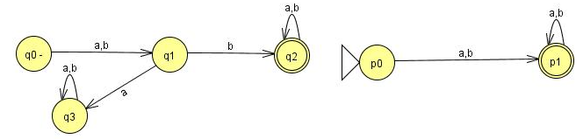
Question (concatenation)
Find FA1FA2 for the following:

Slide 10
Old States | Reading at a | Reading at b
z1-≡q0 | q1≡z2 | q1≡z2
z2≡q1 | q3≡z3 | (q2,p0)≡z4
z3≡q3 | q3≡z3 | q3≡z3
z4+ ≡ (q2,p0) | (q2,p0,p1)≡z5 | (q2,p0,p1)≡z5
z5+≡(q2,p0,p1) | (q2,p0,p1,p1)= (q2,p0,p1)≡z5 | (q2,p0,p1,p1)= (q2,p0,p1)≡z5

Slide 11
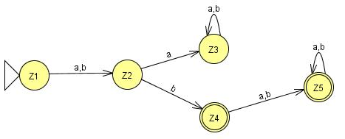

Slide 12
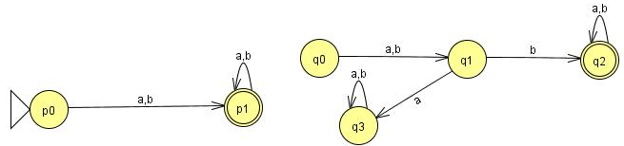
Question (concatenation)
Find FA2FA1 for the following:

Slide 13
Old States | Reading at a | Reading at b
z1-≡p0 | (p1, q0)≡ z2 | (p1, q0)≡ z2
z2+≡(p1, q0) | (p1,q0,q1)≡ z3 | (p1,q0,q1)≡ z3
z3+ ≡ (p1,q0,q1) | (p1,q0,q1,q3)≡ z4 | (p1,q0,q1,q2)≡z5
z4+≡ (p1,q0,q1,q3) | (p1,q0,q1,q3,q3)= (p1,q0,q1,q3)≡z4 | (p1,q0,q1,q2,q3)≡z6
z5+≡(p1,q0,q1,q2) | (p1,q0,q1,q2,q3)≡z6 | (p1,q0,q1,q2,q2)= (p1,q0,q1,q2)≡z5
z6+≡(p1,q0,q1,q2,q3) | (p1,q0,q1,q3,q2,q3)= (p1,q0,q1,q2,q3)z6 | (p1,q0,q1,q2,q2,q3)= (p1,q0,q1,q2,q3)≡z6

Slide 14
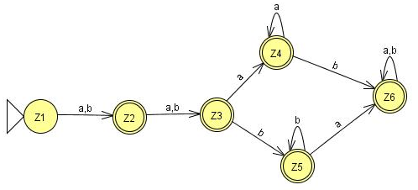

Slide 15
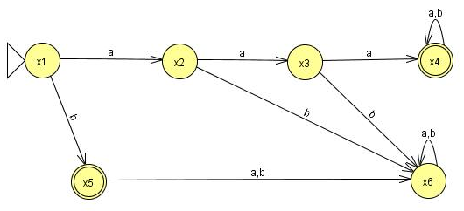
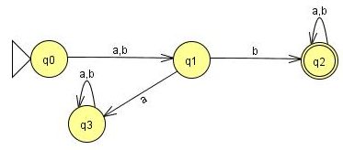
Question (concatenation)
Find FA3FA1 for the following:

Slide 16
Old States | Reading at a | Reading at b
z1- ≡x1 | x2≡ z2 | (x5,q0)≡z3
z2 ≡x2 | x3≡ z4 | x6≡ z5
z3+ ≡(x5,q0) | (x6,q1)≡z6 | (x6,q1)≡z6
z4 ≡x3 | (x4,q0)≡z7 | x6≡ z5
z5 ≡x6 | x6≡z5 | x6≡z5
z6 ≡( x6,q1) | ( x6,q3)≡ z8 | ( x6,q2)≡ z9
z7+≡( x4,q0) | ( x4,q0,q1)≡ z10 | ( x4,q0,q1)≡ z10
z8 ≡( x6,q3) | ( x6,q3)≡ z8 | ( x6,q3)≡ z8

Slide 17
z9+≡( x6,q2) | ( x6,q2)≡ z9 | ( x6,q2)≡ z9
z10+ ≡( x4,q0,q1) | (x4,q0,q1,q3)≡ z11 | (x4,q0,q1,q2)≡ z12
z11+≡( x4,q0,q1,q3) | (x4,q0,q1,q3,q3)= (x4,q0,q1,q3)≡ z11 | (x4,q0,q1,q2,q3)≡ z13
z12+≡( x4,q0,q1,q2) | (x4,q0,q1,q2,q3)≡ z13 | (x4,q0,q1,q2,q2)= (x4,q0,q1,q2)≡z12
z13+≡( x4,q0,q1,q2,q3) | (x4,q0,q1,q3,q2,q3)= (x4,q0,q1,q2,q3)≡z13 | (x4,q0,q1,q2,q2,q3)= (x4,q0,q1,q2,q3)≡z13

Slide 18
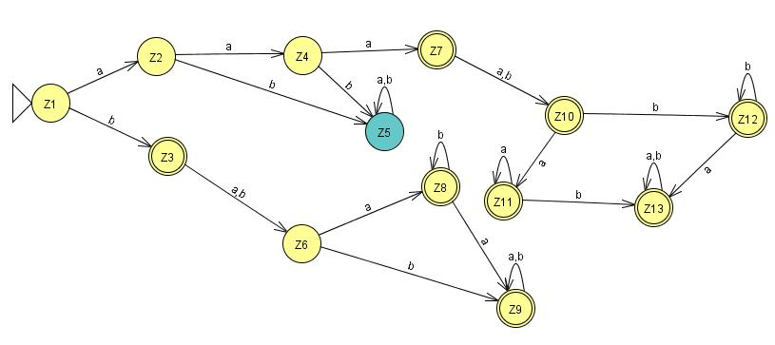

Slide 19
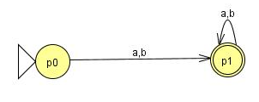
Question (concatenation)
Find FA3FA2 for the following:

Slide 20
Old States | Reading at a | Reading at b
z1- ≡x1 | x2≡ z2 | (x5,p0)≡ z3
z2 ≡x2 | x3≡ z4 | x6≡ z5
z3+≡(x5,p0) | ( x6,p1)≡z6 | ( x6,p1)≡z6
z4 ≡x3 | ( x4,p0)≡z7 | x6≡z5
z5 ≡x6 | x6≡z5 | x6≡z5
z6+≡( x6,p1) | ( x6,p1)≡z6 | ( x6,p1)≡z6
z7+≡( x4,p0) | ( x4,p0,p1)≡ z8 | ( x4,p0,p1)≡ z8
z8+≡( x4,p0,p1) | ( x4,p0,p1,p1)= ( x4,p0,p1)≡z8 | ( x4,p0,p1,p1)= ( x4,p0,p1)≡z8

Slide 21
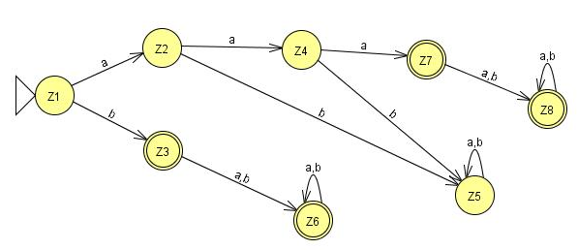

Slide 22
Kleene Theorem (Closure)
If r1 represents a regular expression and r1* the closure of the r1. Similarly, if FA1 corresponds to r1 then FA1* should correspond to closure of r1.
Start by taking the first FA’s and traversing on each input symbol in the respective FA.
Since one initial state is allowed in FA, therefore, only one state can be marked as initial state. Further, the initial state is marked final by default, in order to accommodate NULL string.
During the process, any state found final, the resultant state will be final. Further, the same FA initial state will be concatenated through its final state. The new state will be marked as final.
The final state of the FA will always be combined with the initial state of the FA.

Slide 23
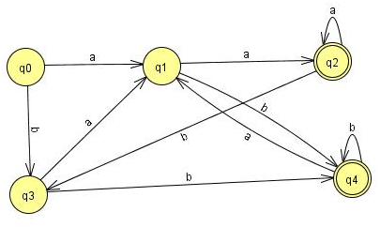
Old States | Reading at a | Reading at b
z1±≡q0 | q1≡z2 | q3≡z3
z2 ≡q1 | (q2, q0)≡z4 | (q4, q0)≡z5
z3 ≡q3 | (q1,q1)≡q1≡z2 | (q4, q0)≡z5
z4+≡ (q2, q0) | (q2, q0,q1)≡z6 | (q3,q3)≡ q3≡z3

Slide 24
z5+≡ (q4, q0) | (q1,q1)≡ q1≡z2 | (q4,q0,q3)≡z7
z6+≡ (q2, q0,q1) | (q2, q0,q1,q2, q0)≡(q2, q0,q1)≡z6 | (q3,q3,q4,q0)≡(q4,q0,q3)≡z7
z7+≡ (q4,q0,q3) | (q1,q1q1)≡q1≡z2 | (q4,q0,q3,q4,q0,)≡(q4,q0,q3)≡z7

Slide 25
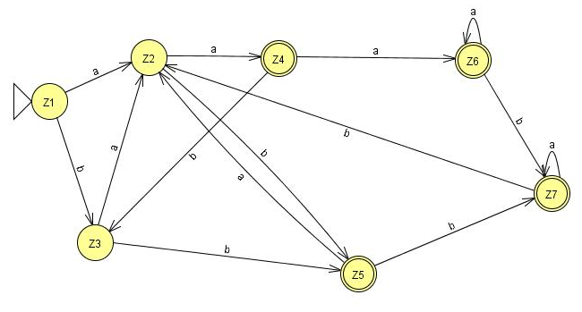

Slide 26
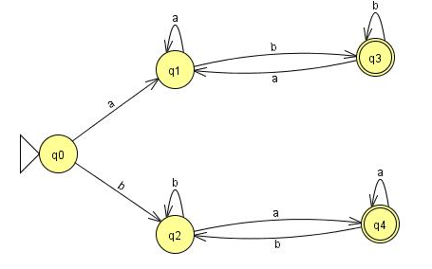
Old States | Reading at a | Reading at b
z1±≡q0 | q1≡z2 | (q3, q0)≡z3
z2 ≡q1 | (q2, q0)≡z4 | (q4, q0)≡z5
z3 ≡(q3, q0) | (q1,q1)≡q1≡z2 | (q4, q0,q1)≡z6
z4+≡ (q2, q0) | (q2, q0,q1)≡z6 | (q3,q3,q0)= (q3,q0)≡z3

Slide 27
z5+≡ (q4, q0) | (q1,q4,q0)≡z7 | (q2,q2)≡q2≡z3
z6+≡ (q3, q0,q2) | (q1,q1,q4,q0)≡(q1,q4,q0)≡z7 | (q3, q0,q2,q2)≡ (q3, q0,q2)≡z6
z7+≡ (q1,q4,q0) | (q1,q4,q0,q1)≡(q1,q4,q0)≡z7 | (q3, q0,q2,q2)≡ (q3, q0,q2)≡z6

Slide 28
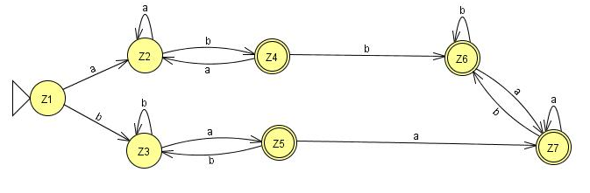

Slide 29
One special requirement for FA’s having an initial state which has a loop or an in coming transition in the closure results in two different states: One non-final state and other one final.

Slide 30
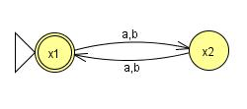
Final Z1≡ x1 | x2≡Z2 | x2≡Z2
x2≡Z2 | x1≡Z1 | x1≡Z1

